Slide 1
Lab - Secured Backend w/ Shared Flow

Slide 2
Wherein ...
We would like to make PUT calls to update a product
Updates to the backend requires basic authentication
Use credentials from a Key-Value map to authenticate
Use a Shared Flow to contain the KVM and BasicAuth functionality
Leverage the Shared Flow within the proxy to communicate with the secured backend

Slide 3
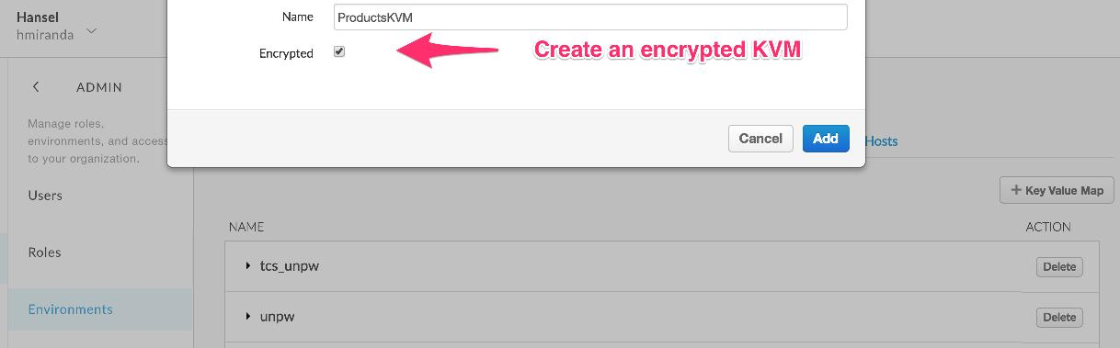
Configure a Key-Value Map (KVM)
Make sure the KVM is created in the Test environment
Check the encrypted box, since we are storing credentials data

Slide 4
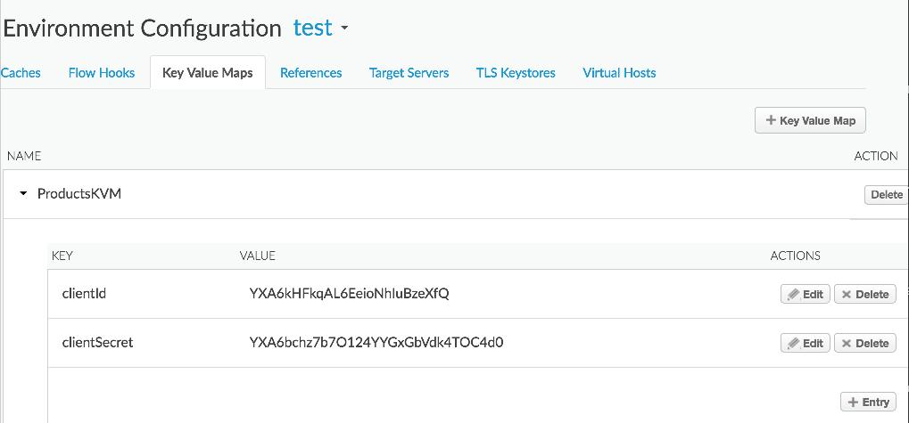
Configure a Key-Value Map (KVM)
Add the clientId and clientSecret entries to the map
clientId: YXA6kHFkqAL6EeioNhIuBzeXfQ
clientSecret: YXA6bchz7b7O124YYGxGbVdk4TOC4d0

Slide 5
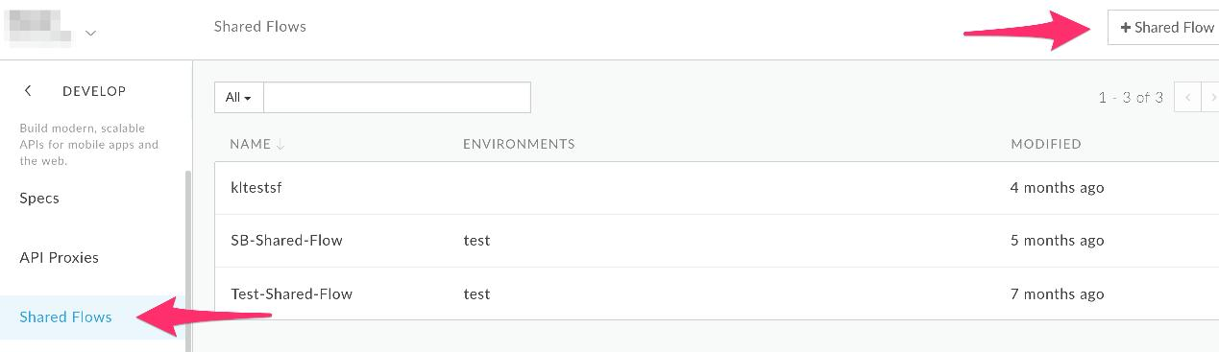
Create a Shared Flow
Click on the +Shared Flow button to create a new Shared Flow
Provide a name and description for your Shared Flow bundle in the dialog

Slide 6
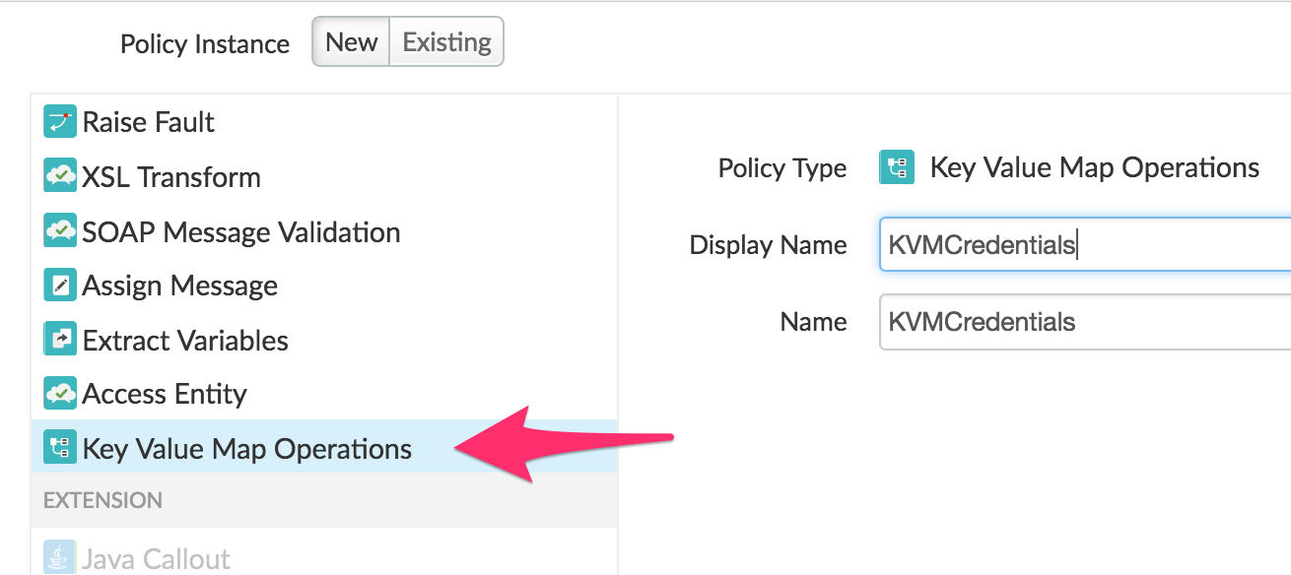
Add a KeyValueMapOperations policy to the shared flow

Slide 7
Update the KVM policy xml
Add the mapIdentifier attribute to use the name of the encrypted KVM
<?xml version="1.0" encoding="UTF-8" standalone="yes"?>
<KeyValueMapOperations async="false" continueOnError="false" enabled="true" name="KVMCredentials" mapIdentifier="ProductsKVM">
<DisplayName>KVMCredentials</DisplayName>
<Properties/>
<ExclusiveCache>false</ExclusiveCache>
<ExpiryTimeInSecs>300</ExpiryTimeInSecs>
<Get assignTo="private.clientId" index="1">
<Key>
<Parameter>clientId</Parameter>
</Key>
</Get>
<Get assignTo="private.clientSecret" index="1">
<Key>
<Parameter>clientSecret</Parameter>
</Key>
</Get>
<Scope>environment</Scope>
</KeyValueMapOperations>

Slide 8
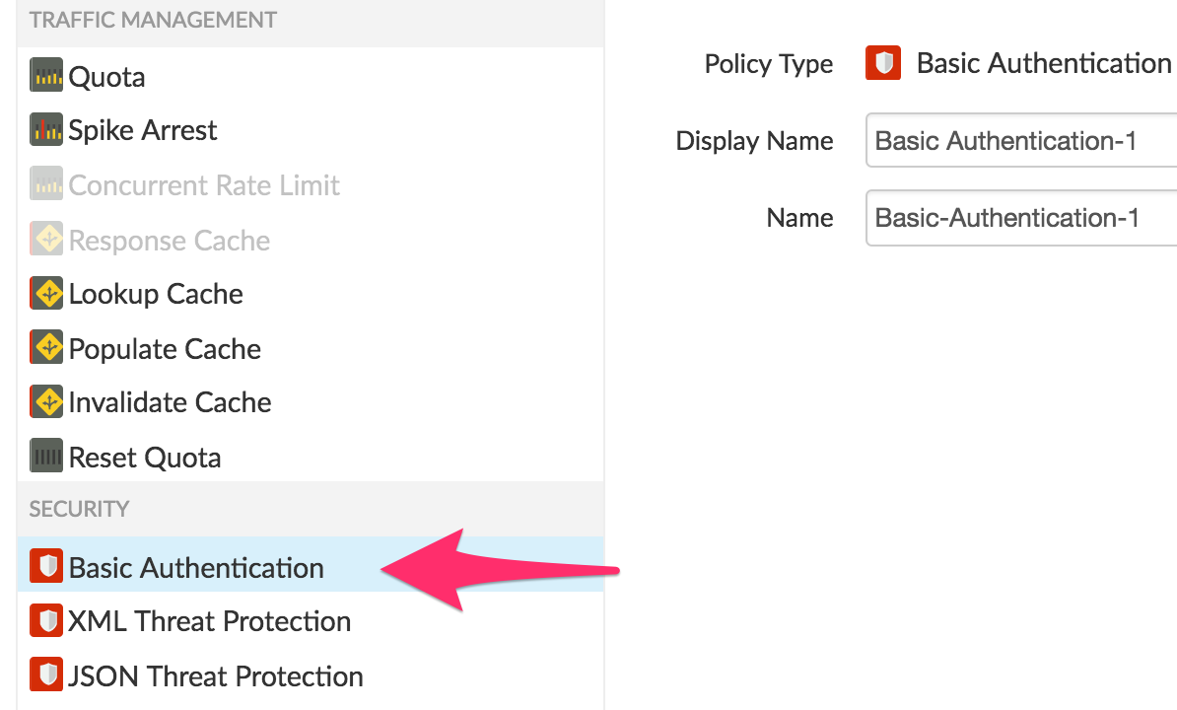
Add a BasicAuthentication policy to the shared flow
Use the Encode operation to base64 encode clientId and clientSecret
Save it to the request as the Authorization header

Slide 9
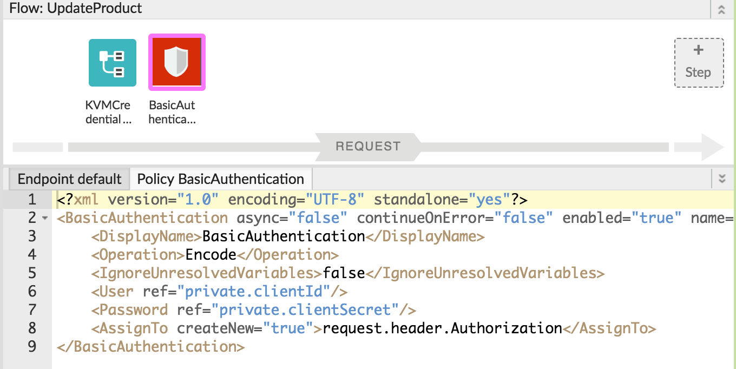
BasicAuthentication policy

Slide 10
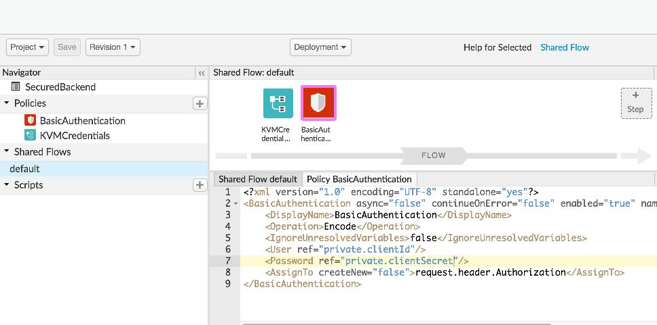
Shared Flow
Save and Deploy the Shared Flow to the Test environment

Slide 11
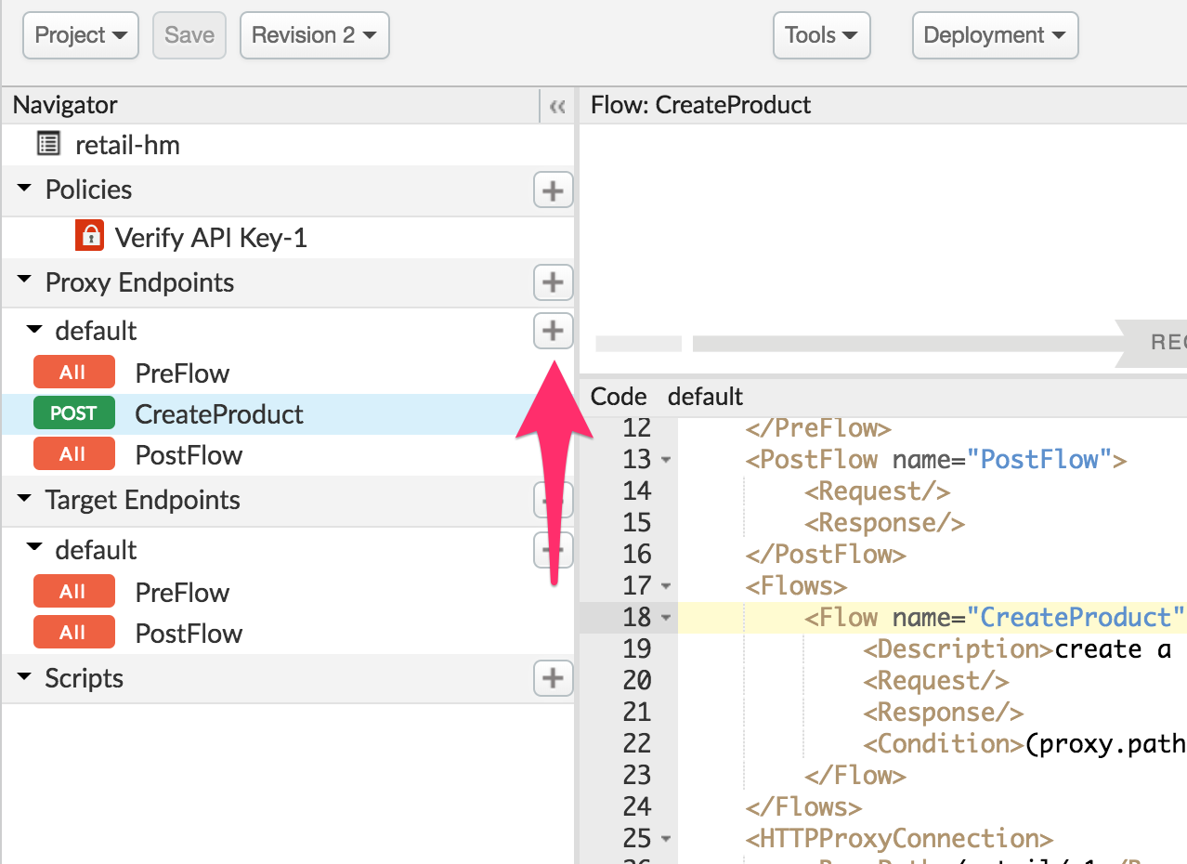
Create a PUT resource or Conditional flow
Create a new PUT resource in the
Proxy Endpoint for /products

Slide 12
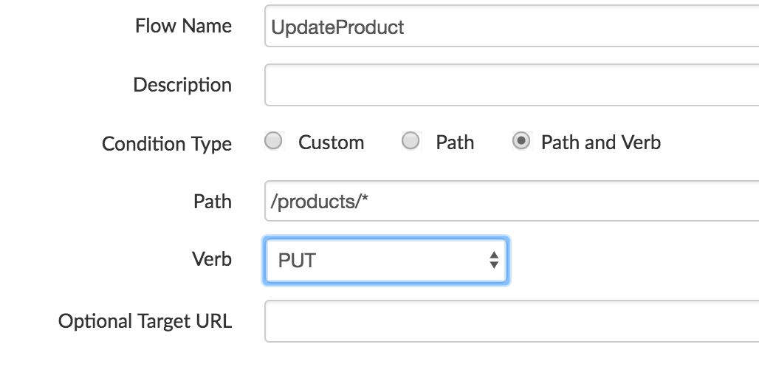
Create a PUT resource or Conditional flow
Create a new PUT resource in the
Proxy Endpoint
Condition Type:
path and verb
Verb: PUT --
Path: /producs

Slide 13
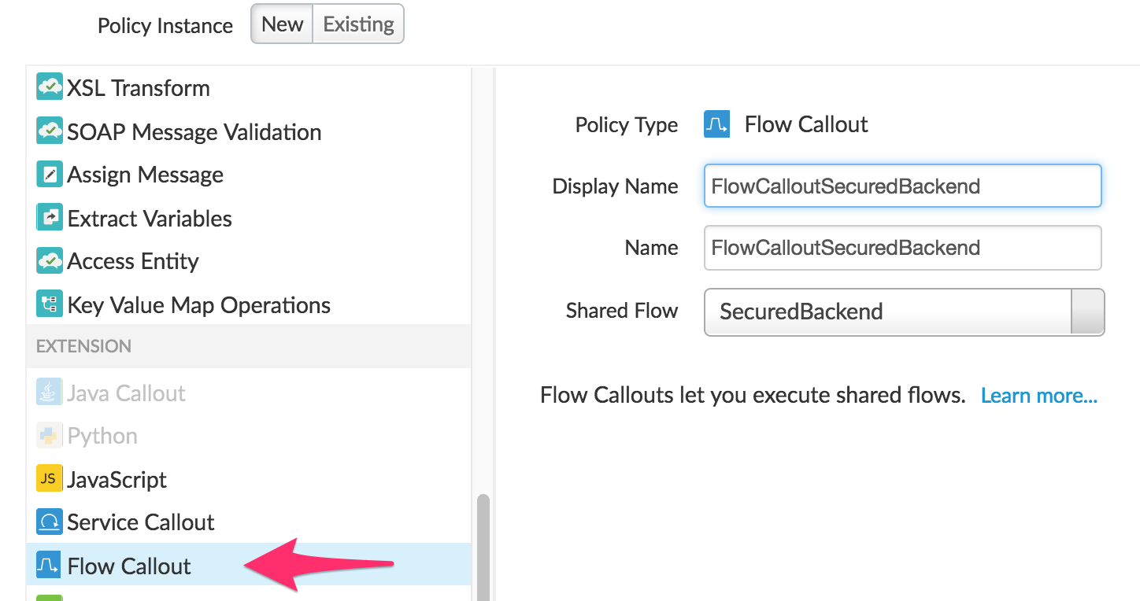
Add a Flow Callout policy to the UpdateProduct flow
FlowCallout policy refers to the SecuredBackend shared flow

Slide 14
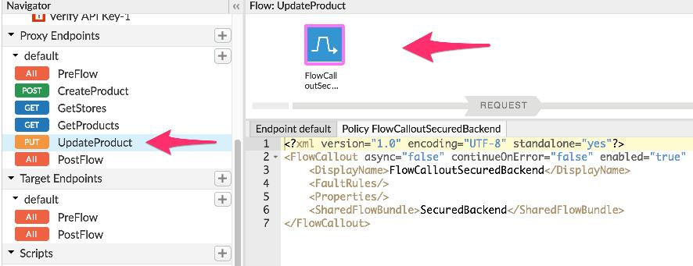
Flow Callout policy in the UpdateProduct flow
Save and Deploy the proxy to the Test environment

Slide 15
Test
A partial Product JSON below to update the Product.
{
"overall_rating": 9.9
}
Test the PUT /products/{product_name} endpoint with the above payload
Substitute the {product_name} with the actual name of the product to be updated

Slide 16
THANK YOU

